Slide 1
Brynteg School Bridgend
Kate Perna
Learning Director for Pupil Participation Head of Geography
ka.perna@bryntegcs.bridgend.sch.uk

Slide 2
Aims
Brief introduction to Brynteg
Our SHRN journey
Use of data
School research involvement

Slide 3
Brynteg School
Mixed 11-18 Comprehensive School
Urban area with a population of approximately 50,000.
Approximately 1500 on roll including 400 in 6th Form (largest in the county)
60% L2 including English & Maths, grade C and above (2018)
Approx 13% FSM
Draw pupils from a wide variety of socio-economic backgrounds and ethnically the school is predominantly white, British.

Slide 4
Our journey with SHRN to date…
Joined the network in 2013
2013/14 = 126 pupils (sample)
2015/16 survey = 1244 pupils
2017/18 survey = 1161 pupils

Slide 5
Who have the results been shared with?
ALL STAFF
Senior Leadership Team
Progress Leaders & Assistant Progress Leaders
Subject Leaders – PSE in particular
PCSO & other support staff
Parents
Governors
Pupils
SIG (School Improvement Group)

Slide 6
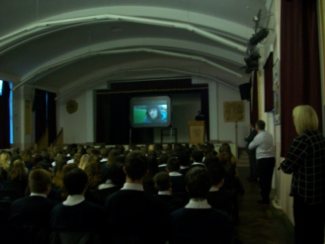
How have the results been used? STAFF
PSE curriculum
Further interrogation of the data from SHRN in relation to New Psychoactive Substances
Met with school Police Liaison Officer and PSE Subject Leader
Discussed issues in relation to this topic around the Bridgend area to feed into the lessons.
Delivered a talk to Year 10 on this topic – students off timetable to stress importance of this and introduced distinct workshops in Year 9 on ‘Wellbeing Day’

Slide 7
How have the results been used? PARENTS
Mail shots to parents
Used some of the results from the questionnaire and created information sheets included in the ‘Brynteg News’ (online school bulletin)
Included information from government guidelines and had support from Healthy Schools Practitioner to provide accurate and up to date information to parents.
Liaised with ‘Healthy Schools’ co-ordinator to obtain most up to date guidelines.

Slide 8
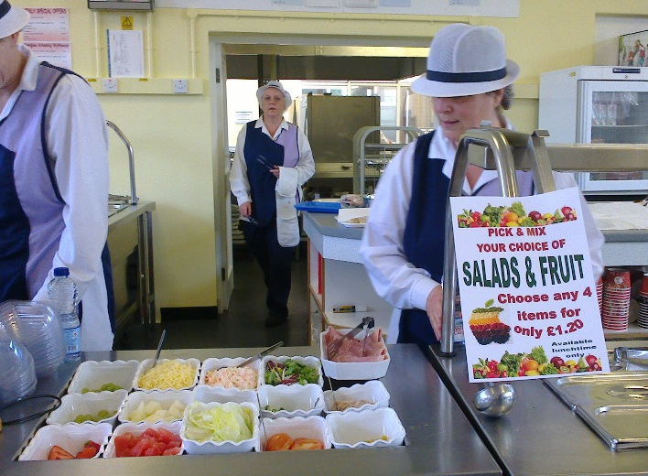
How have the results been used? PUPILS
In conjunction with School Council work
Through pupil voice, it was identified that students wanted to review the canteen provision, especially the variety of healthy foods available.
The school council met to discuss how to tackle this and making use of the well being data in relation to this topic a highly successful review and revamp was carried out of the foods available.
One canteen has been renovated and opened as a café as our older pupils wanted access to food throughout the morning – we had identified that many were skipping breakfast from the survey.

Slide 9
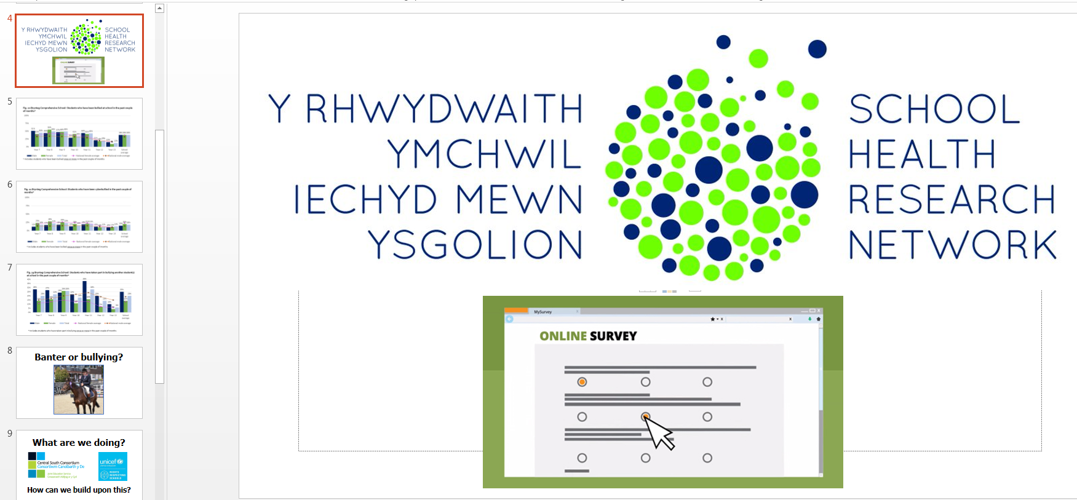
How have the results been used? PUPILS
Shared with pupils in assemblies.
Theme 0f the week – ‘Responsible Behaviour’
Linked with ‘Bullying’ section and launched
Anti-bullying campaign ahead of anti-bullying week.
Increase in discussion about the topic following the assembly and in numbers supporting the campaign.

Slide 10
How have the results been used? SIG
School Improvement Group (Regional Improvement Collaborative)
Shared summaries from the report across the group and prioritised 3 common areas to develop PSE resources/assemblies to share with the group.
Informal discussions and sharing of ideas and contacts and opportunities.

Slide 11
Research opportunities and University Links
Opportunity to take part in world leading research
Participate in specific studies that may help to address school based issues.
Provide a link between the school and Higher Education to support students now and develop their understanding of what happens at University.
Offer professional advice about the development and practicalities of new school based studies.
Access to literature to support Professional Development.
Contemporary methods of sharing feedback through Webinars and reports.

Slide 12
Diolch yn fawr! Thank you! ka.perna@bryntegcs.bridgend.sch.uk

